Slide 1
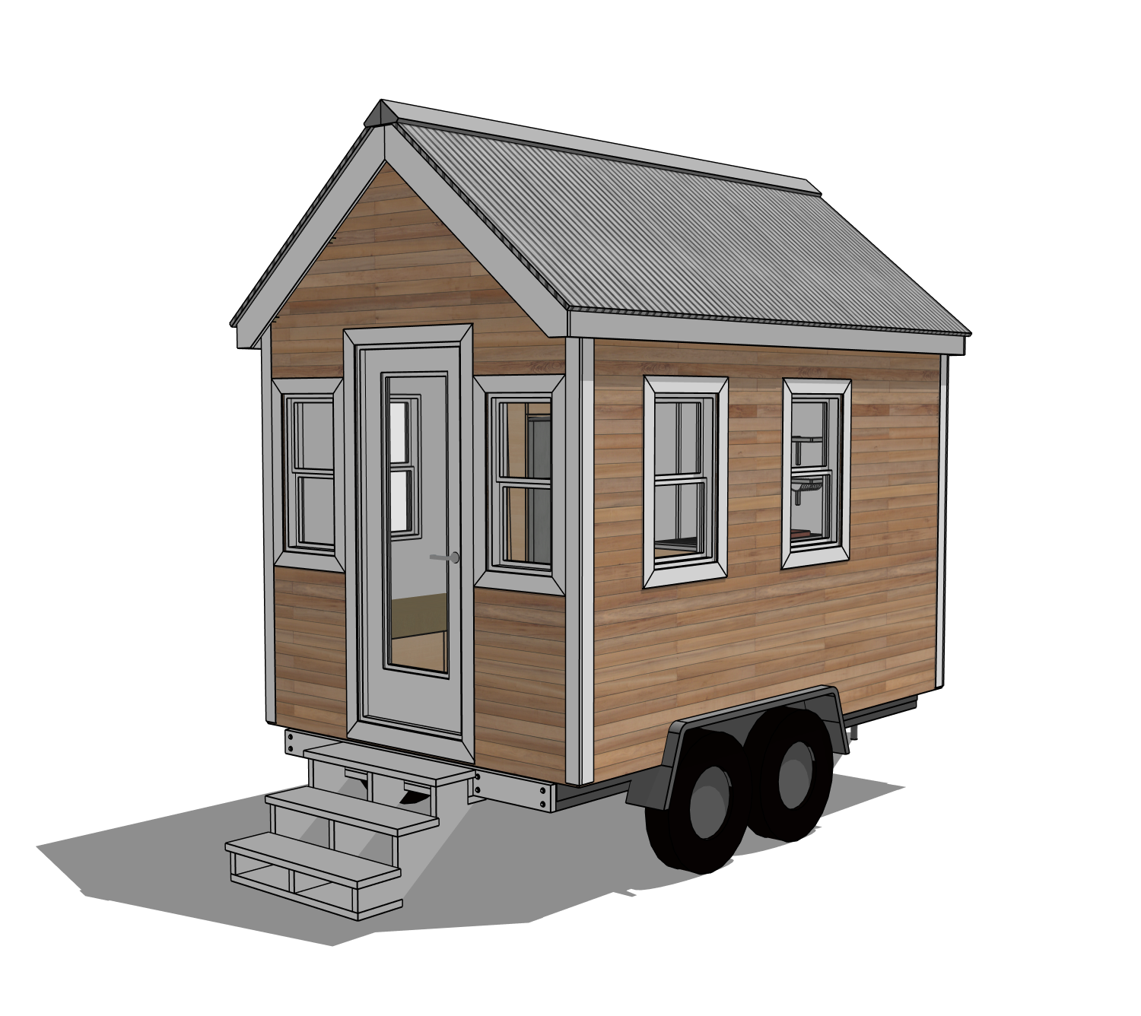
TINY_LOGIC // 01
RAY_JANZEN
Tiny Logic:
The Math of Tiny House Design
Architecture is geometry. In a tiny house, every inch counts. This project explores the math you need to design a tiny house on wheels.
If geometry is a tough subject for you, seeing how the math works with a real house design might help you see how the math works.

Slide 2
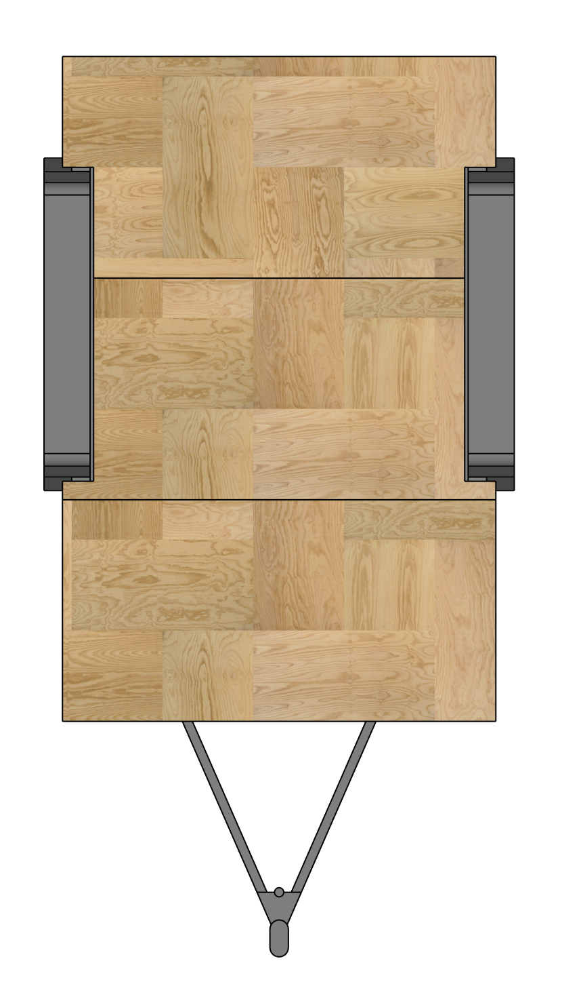
TINY_LOGIC // 02
8 feet
RAY_JANZEN
Floor Plan Geometry
Area and Perimeter
To maximize living space within road-legal limits, we calculate the floor area and perimeter to size the foundation.
Area = Length x Width
Permieter = Length of all walls added together
For a 12 foot long by 8.0 foot wide house:
Perimeter: 2(12 + 8) = 40 feet of wall framing
Area: 12 × 8 = 96 square feet
12 feet

Slide 3
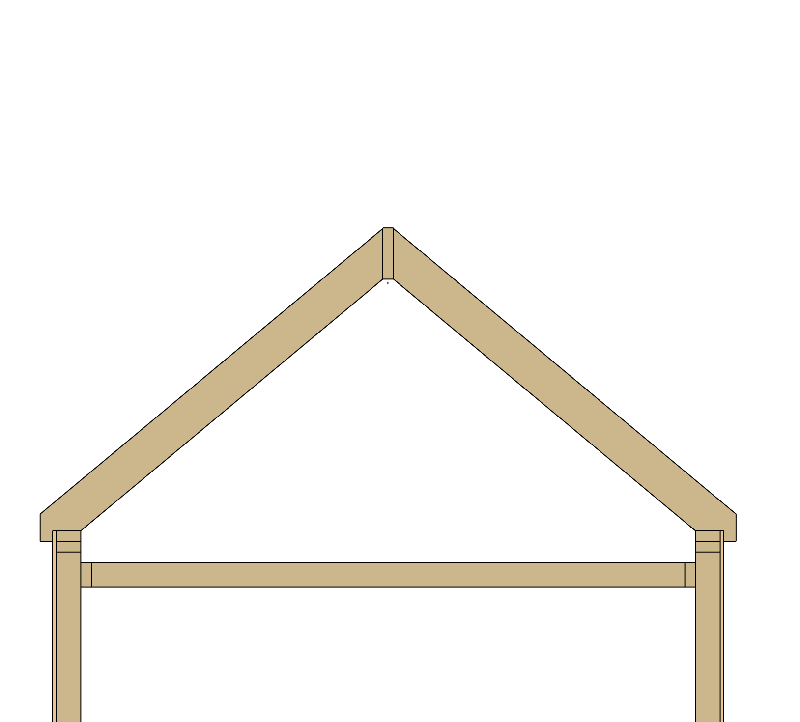
TINY_LOGIC // 03
RAY_JANZEN
The Roof Structure
Pythagorean Theorem
Calculating the rafter length (hypotenuse) for a gabled roof allows us to order precision-cut lumber.
a² + b² = c²
4² + 3² = c²
16 + 9 = 25
c = √(25) = 5 feet per rafter.
c = 5 feet
b = 3 feet
a = 4 feet

Slide 4
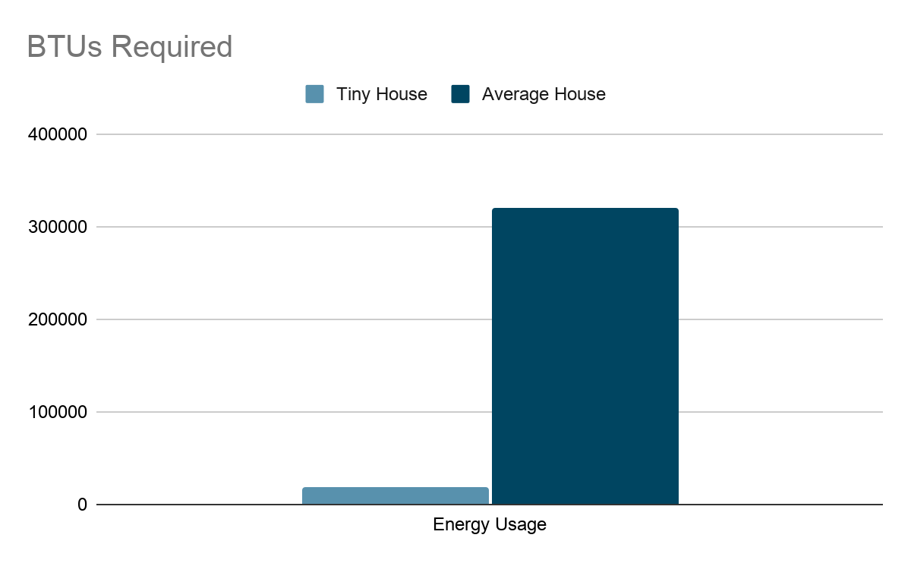
TINY_LOGIC // 04
RAY_JANZEN
Energy vs. Volume
Tiny houses are more efficient because their Cubic Volume is lower. This chart shows the BTU (British Thermal Units) heating requirements as the volume of the space increases.
Volume = length x width x height
Required BTUs = Volume x 20
To size our mini-split air conditioner, we calculate the cubic volume of the house. Our house is 12 feet long, 8 feet wide, and has an average interior height of 10 feet.
12 x 8 x 10 = 960 cubic feet. Multiplying by 20 BTUs per cubic foot means we need a 19,200 BTU heater. A 2,000 sq ft home requires over 320,000 BTUs!

Slide 5






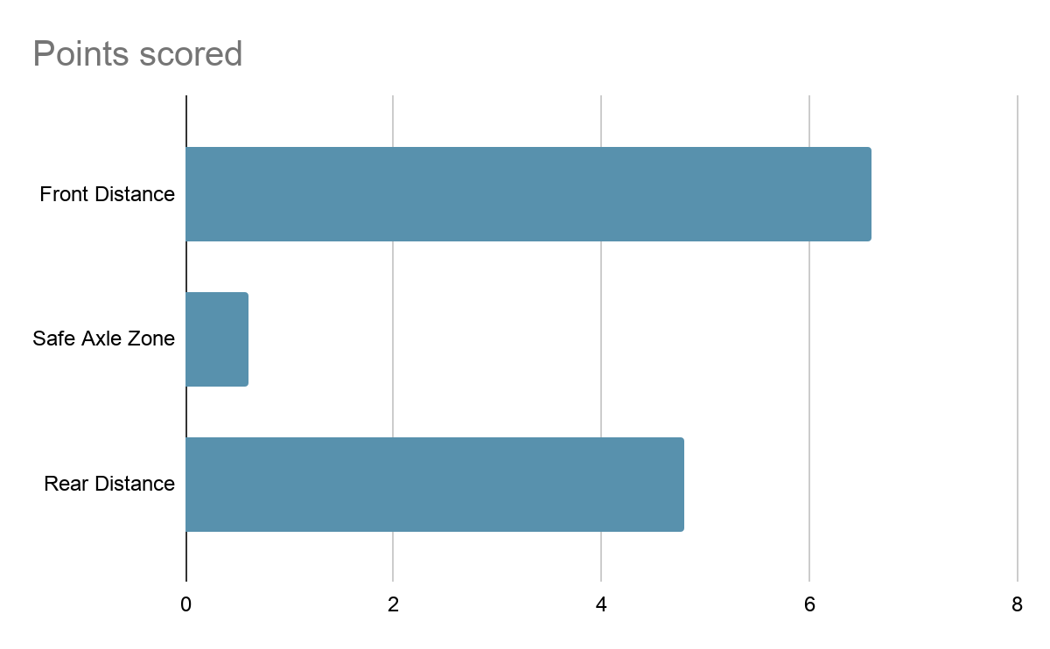
TINY_LOGIC // 05
RAY_JANZEN
Physics of Towing
10-15%
Center of Mass
GVWR
Target Tongue Weight percentage relative to total house weight for safe highway towing.
Located roughly 55-60% of the way back from the front of the trailer bed.
Gross Vehicle Weight Rating must exceed total load to prevent axle failure.
Finding the Center of Mass
To prevent trailer sway, the axles must be mounted between 55% and 60% of the way back from the front hitch. For a 12-foot house:
Minimum Distance: 12 feet x 0.55 = 6.6 feet
Maximum Distance: 12 feet x 0.60 = 7.2 feet
The center of the wheels must sit inside this 0.6-foot safe zone.

Slide 6
TINY_LOGIC // 06
RAY_JANZEN
Legal Road Constraints
8.5'
13.5'
The Inequality Constraint
To avoid a "wide load" permit, our design must satisfy the following mathematical inequality:
Width ≤ 8.5 feet
Height ≤ 13.5 feet
MAXIMUM WIDTH
MAXIMUM HEIGHT

Slide 7
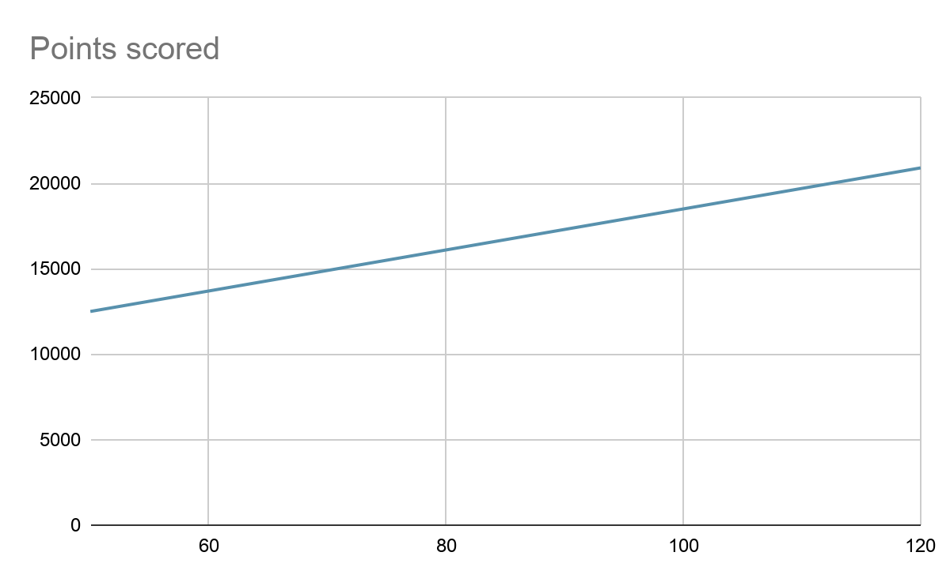
TINY_LOGIC // 07
RAY_JANZEN
Budget Modeling
Total cost follows a linear model: y = mx + b, where b is the fixed trailer cost ($6,500) and m is materials per sq ft.
We can predict our budget using a linear equation. Our custom trailer has a fixed cost of $6,500. We estimate materials will cost $120 per square foot. For our 96 square foot home, the equation is:
y = 120(96) + 6500
y = 11520 + 6500
Total estimated cost = $18,020.

Slide 8
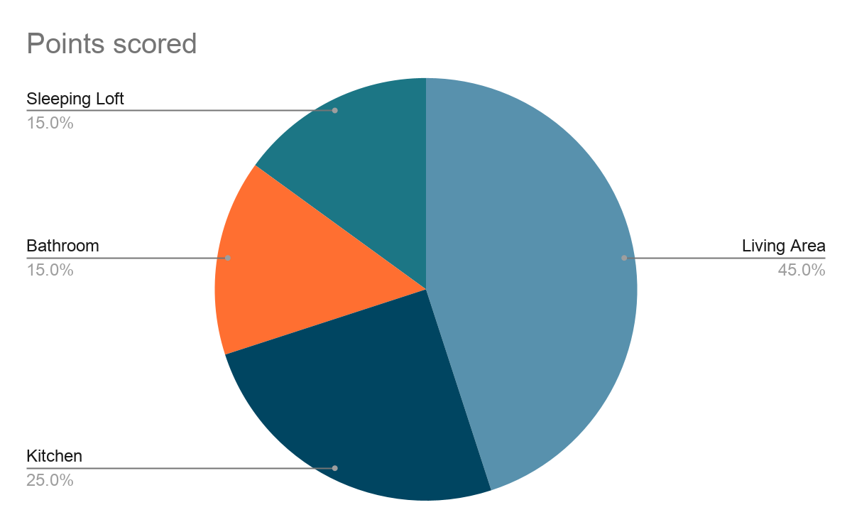
TINY_LOGIC // 08
RAY_JANZEN
Space Allocation
Percentage Distribution
•
45% Living Area: Multi-functional space
•
25% Kitchen: High-efficiency appliances
•
15% Bathroom: Compact utility wet-room
•
15% Sleeping Loft: Vertical space utilization
Note: Maximizing the living area improves the "perceived" square footage.

Slide 9
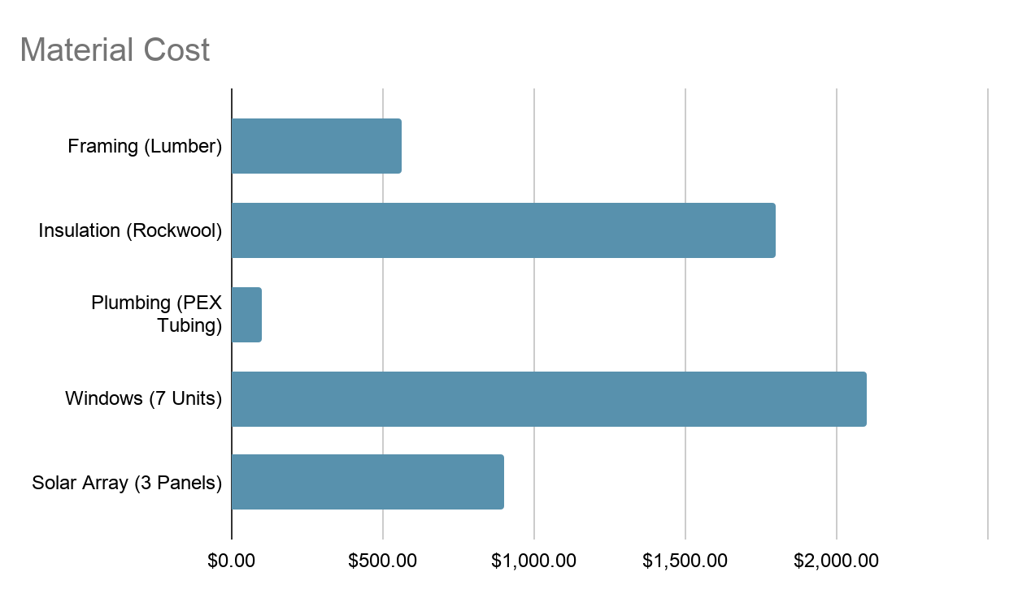
TINY_LOGIC // 09
RAY_JANZEN
Materials
Component | Metric / Measurement | Math Applied
Wall Studs | 140 pcs (2x4x8) | 16" on-center spacing
Insulation (Rockwool) | 1,200 Board Feet | Surface Area calculation
Windows | 7 Units (Varying Sizes) | Light-to-Floor Area Ratio
Solar Array | 3 Panels (400W each) | Daily kWh consumption model

